Slide 1




HELLO
WORLD

Slide 2

IDENTITY YOURSELF
NAME: RIK
Born: 1976
CAREER:
SOFTWARE
DEVELOPMENT

Slide 3
WHAT DO YOU ACTUALLY DO?
Make apps that help people
Work in a big team of lovely people
Make apps nice to use
Enjoy finding ways to make things work
Do lots of hard thinking

Slide 4
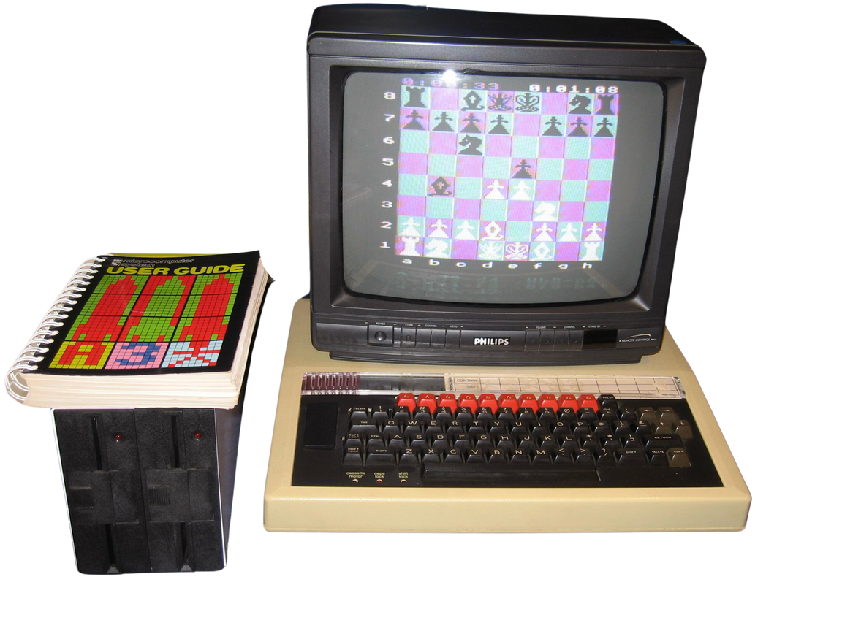

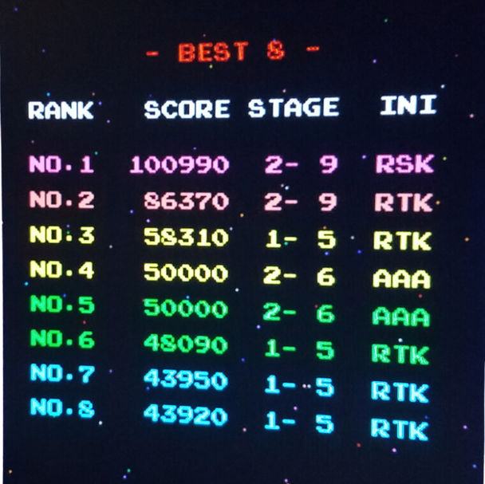
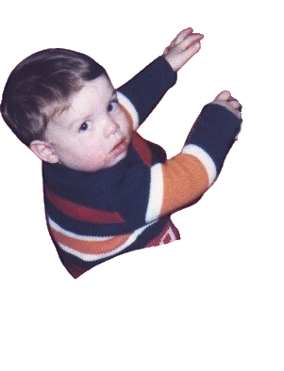

HOW DID THIS OCCUR?
Richard
Mark
Hemsley
RIK

Slide 5
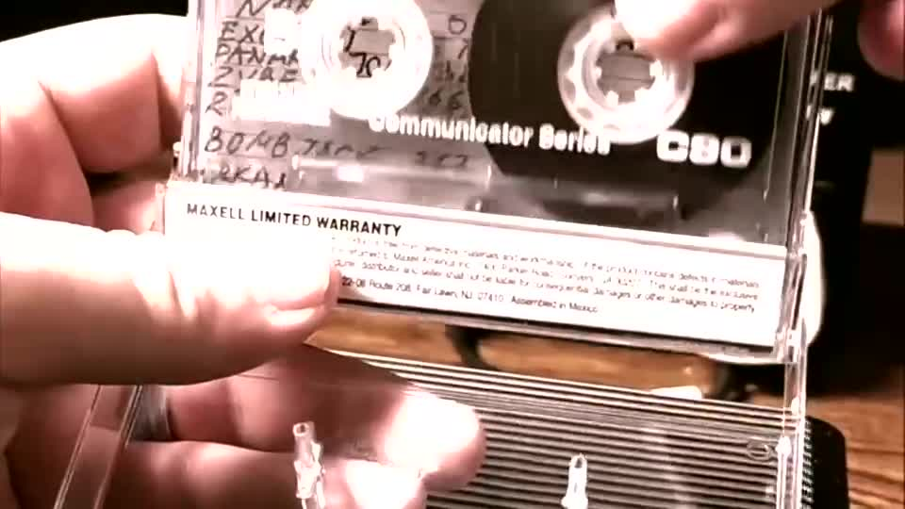
What was it like in the 80s?

Slide 6
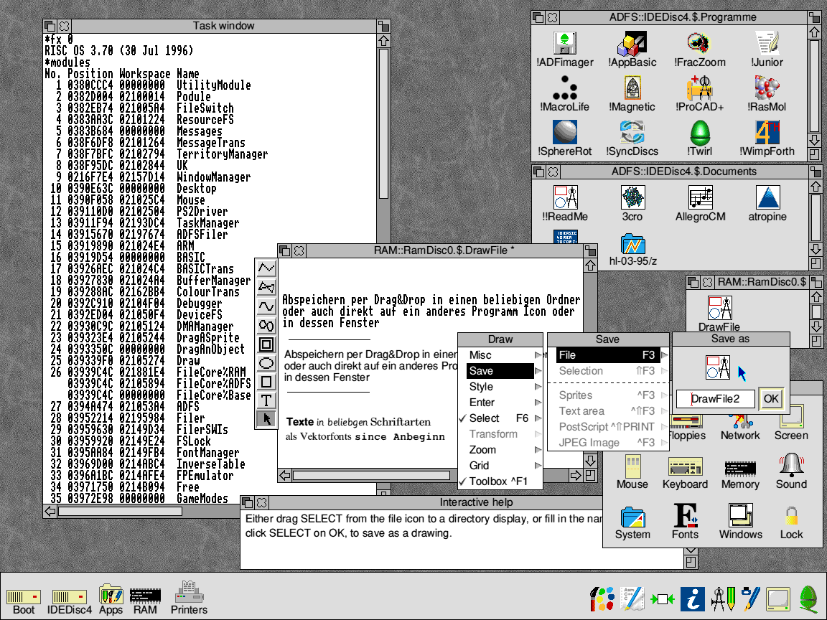
cool looking computers existed

Slide 7
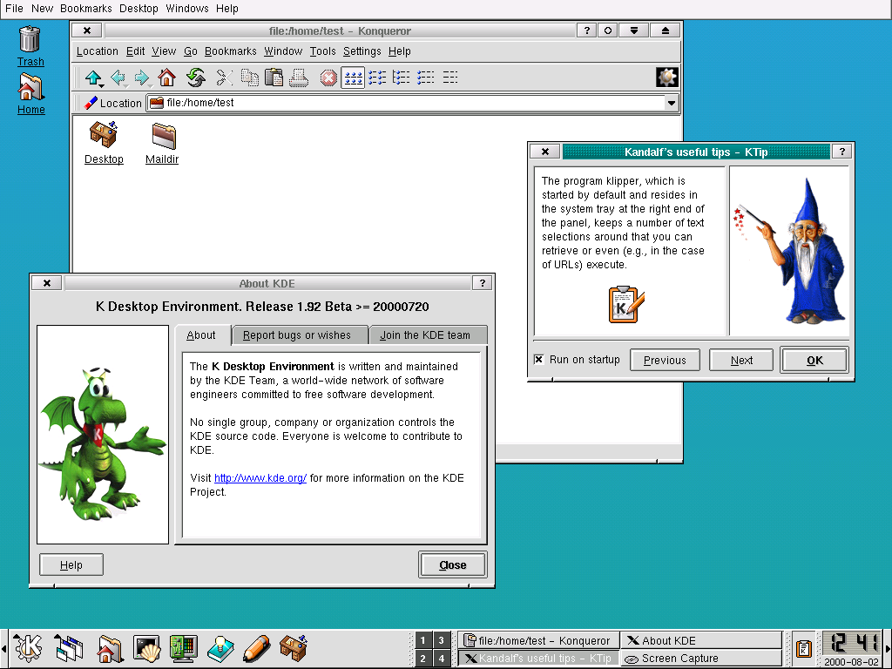
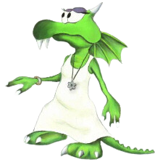
I can do that

Slide 8
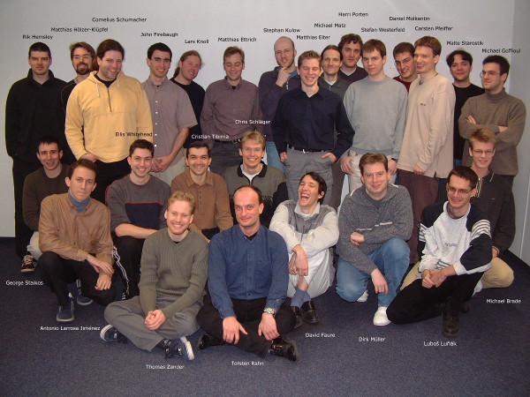
DOES ANYONE READ THESE?

Slide 9
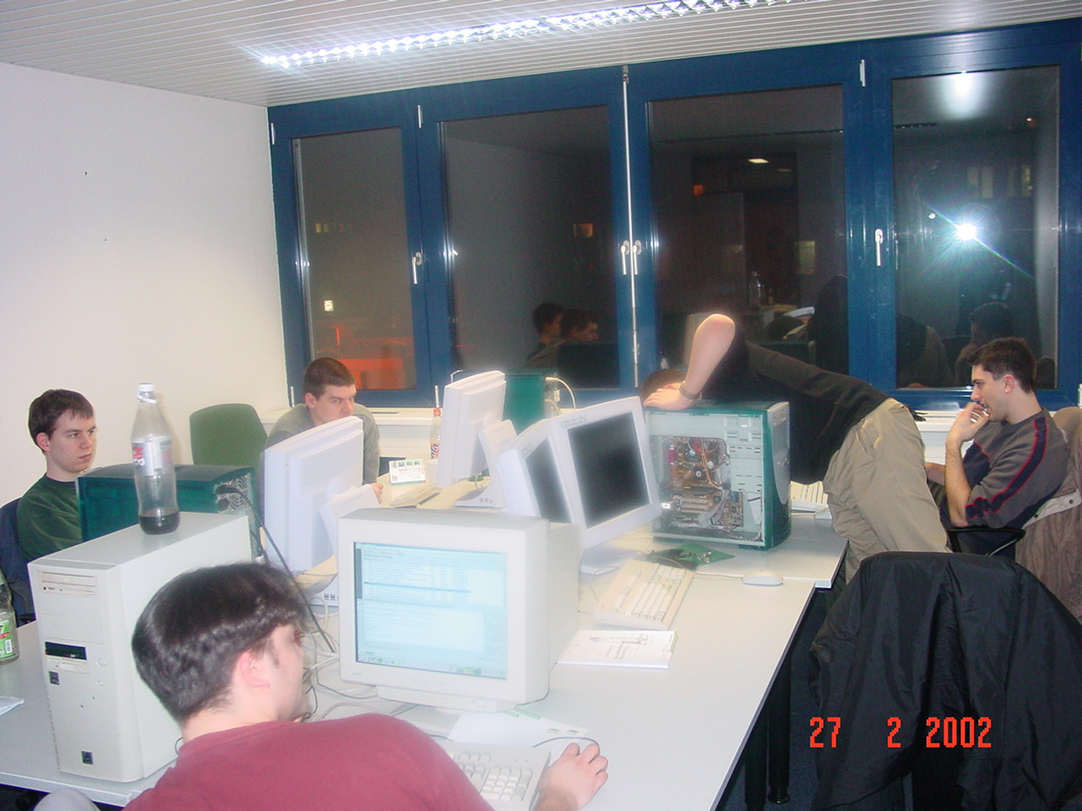
OH I GIVE UP

Slide 10
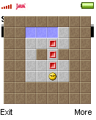
OH I GIVE UP

Slide 11
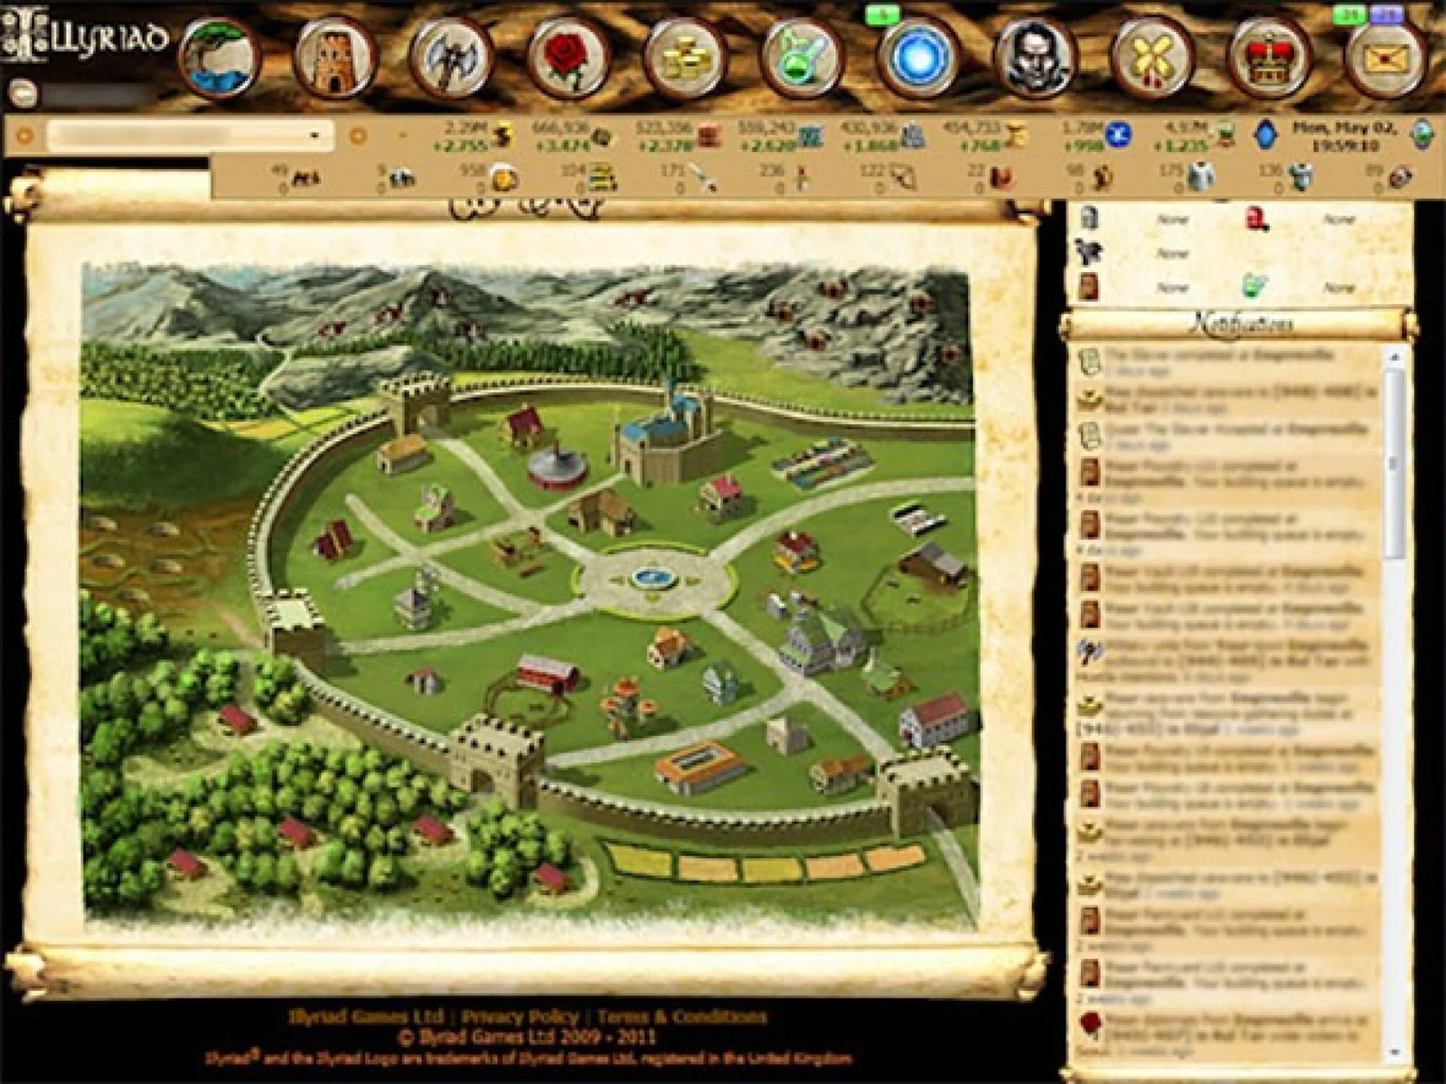
ILLYRIAD
“The best games to secretly play at work”

Slide 12
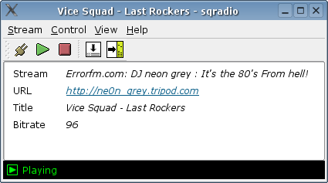
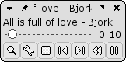
sqradio

Slide 13
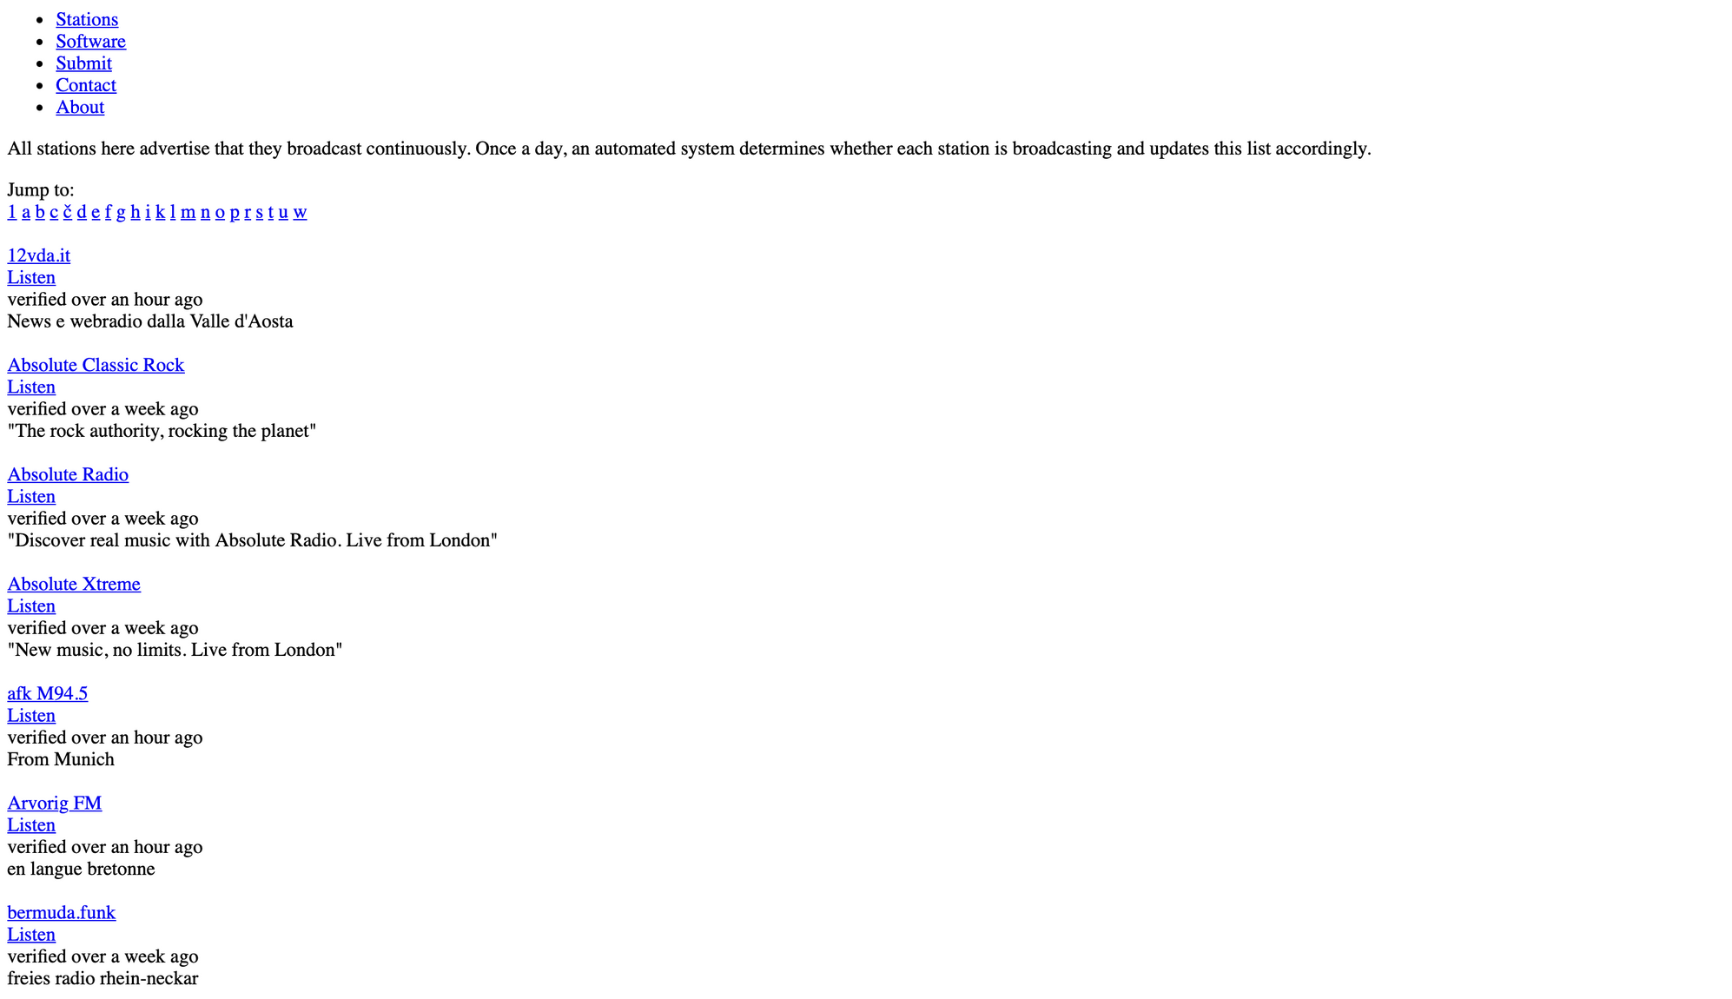
openradio
what?

Slide 14
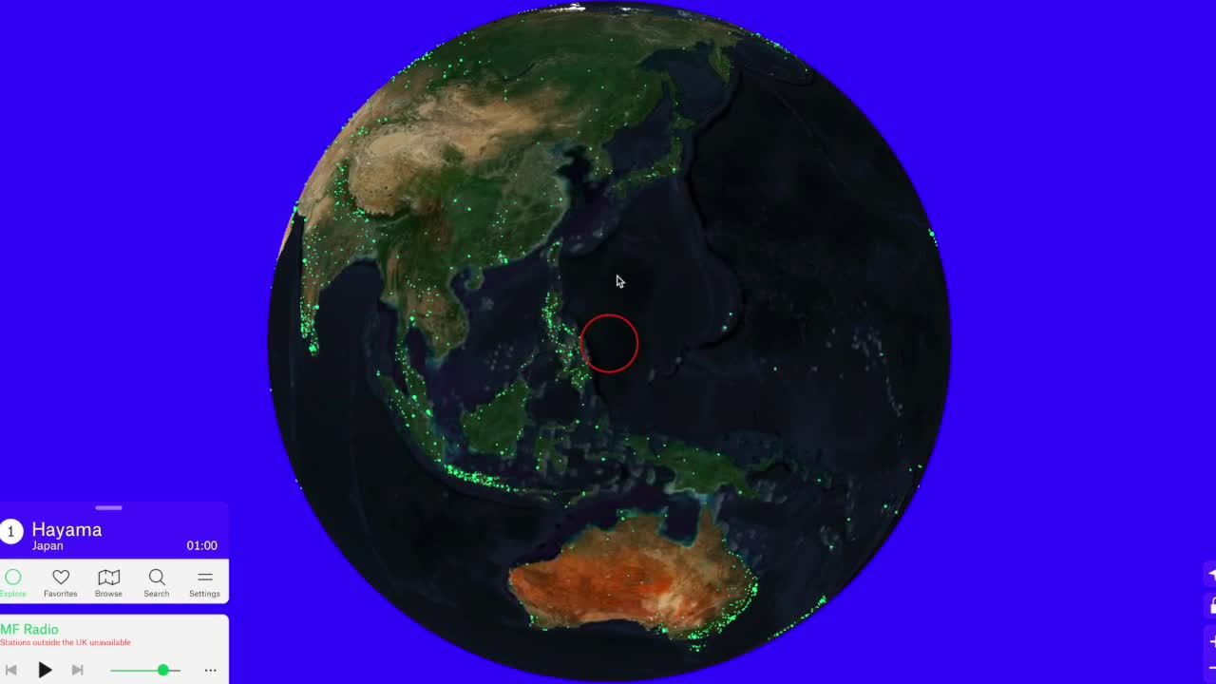
radio.garden
I didn’t make this

Slide 15
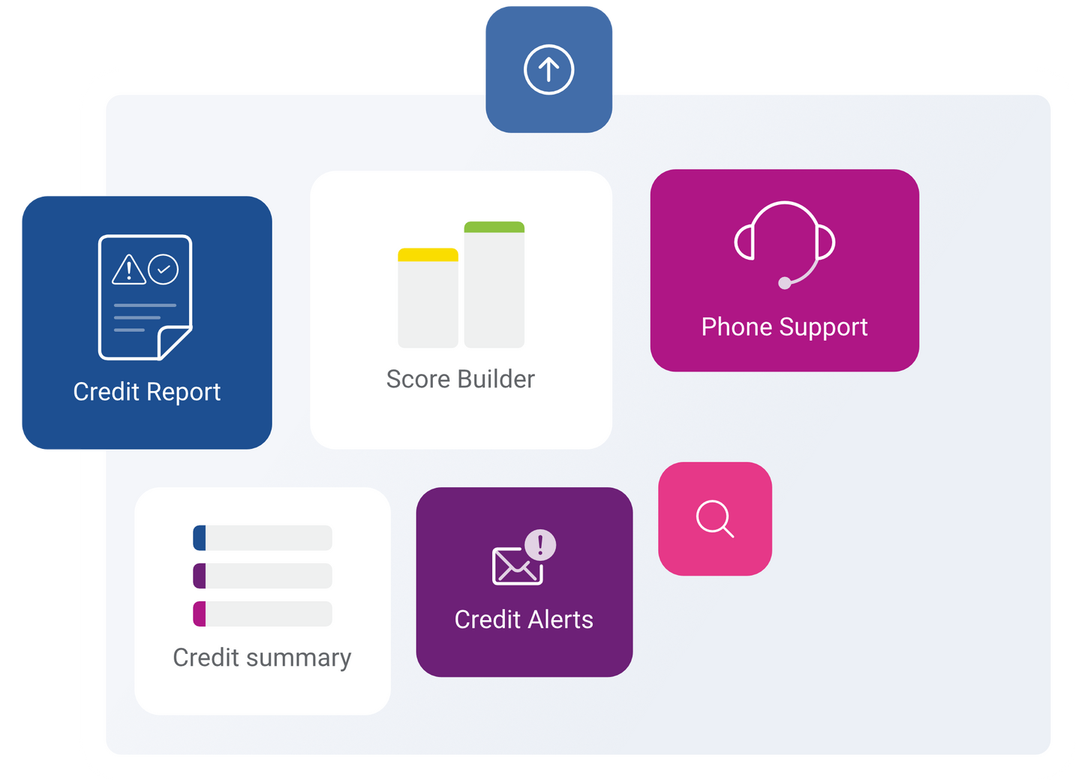

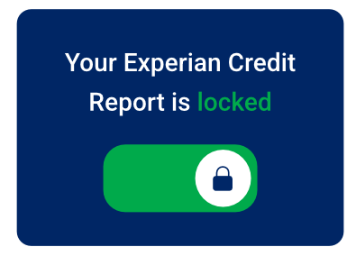
WHAT IS YOUR FUNCTION?
Help people to protect the money they earn, avoid spending too much, and to be confident in making plans

Slide 16

What’s good?
And what’s not quite as good?

Slide 17

WHAT DO YOU LOVE ABOUT YOUR JOB?
IS IT THE ROBOTS?

Slide 18

WHAT DO YOU LOVE ABOUT YOUR JOB?
IS IT THE ROBOTS?
YES

Slide 19
WHAT DO YOU LOVE ABOUT YOUR JOB?
IS IT THE ROBOTS?
YES
WELL, NO

Slide 20
WHAT DO YOU LOVE ABOUT YOUR JOB?
IS IT THE ROBOTS?
YES
WELL, NO
ROBOTS DON’t FEATURE AS MUCH AS YOU MIGHT THINK

Slide 21
WHAT DO YOU LOVE ABOUT YOUR JOB?
MAKING COOL, USEFUL APPS
SOLVING HARD PROBLEMS
VARIETY
LEARNING

Slide 22
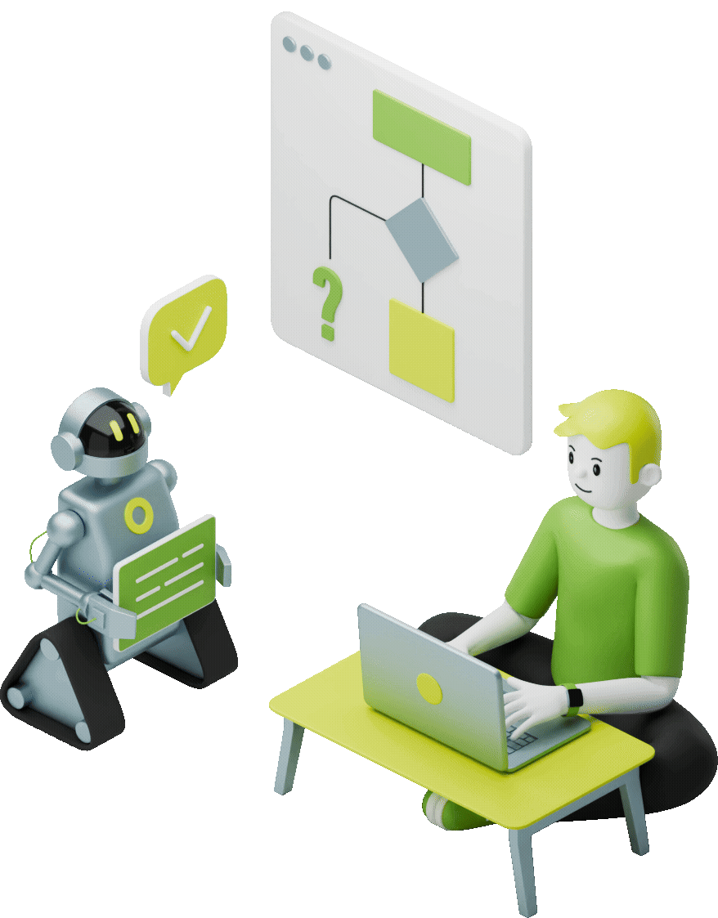
WHAT DO YOU LOVE ABOUT YOUR JOB?
HELPING PEOPLE
MAKING COOL, USEFUL APPS
SOLVING HARD PROBLEMS
VARIETY
LEARNING

Slide 23
What’s hard about it?
EVERYTHING

Slide 24

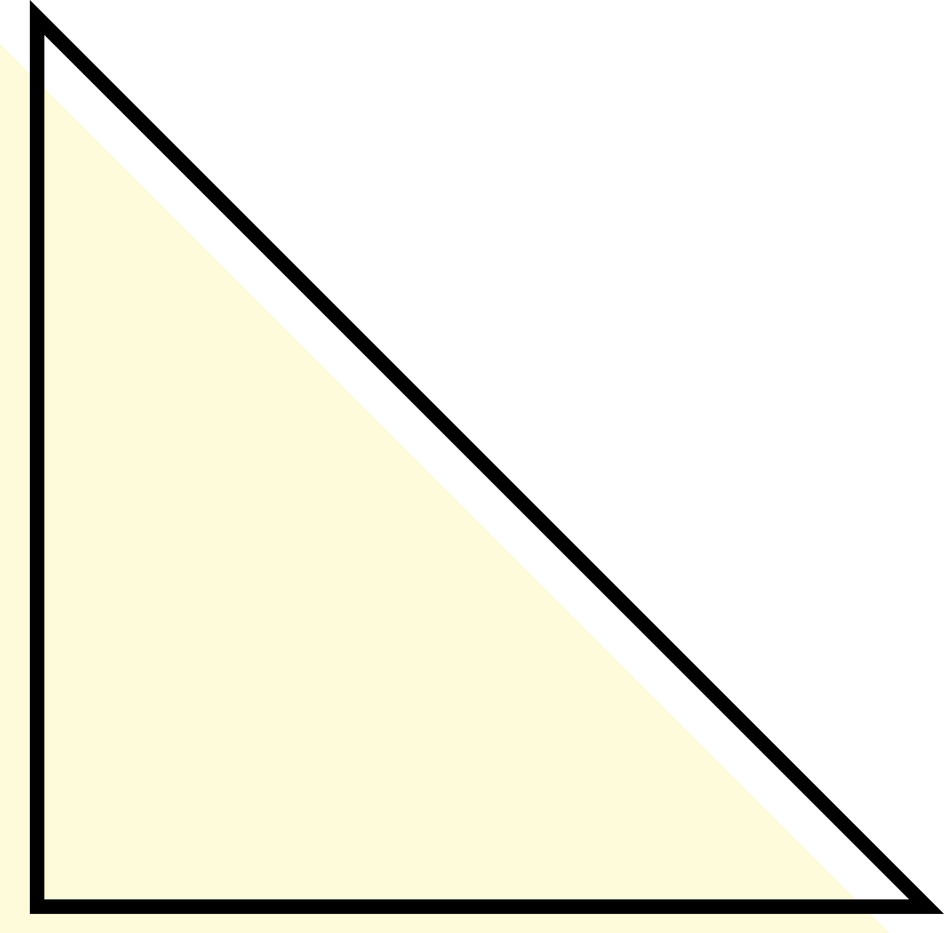
What’s hard about it?
EVERYTHING
But I look forward to work
AND I WISH I HAD MORE SPARE TIME SO I COULD BUILD MORE

Slide 25
What
WILL
you
do
?
What
WILL
you
do
?

Slide 26
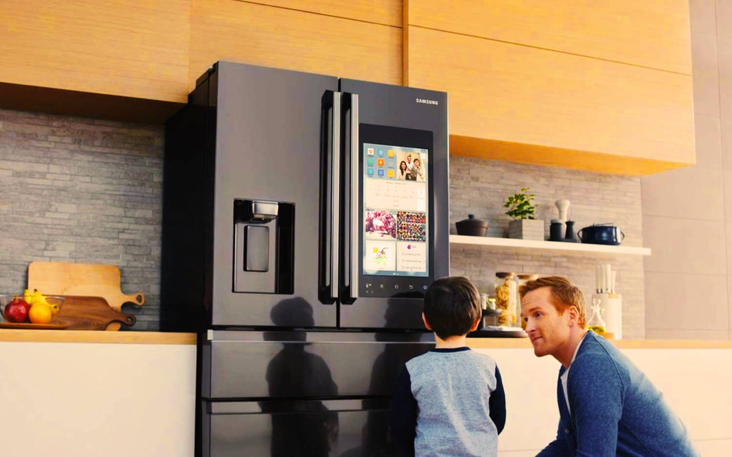
Smart devices?

Slide 27
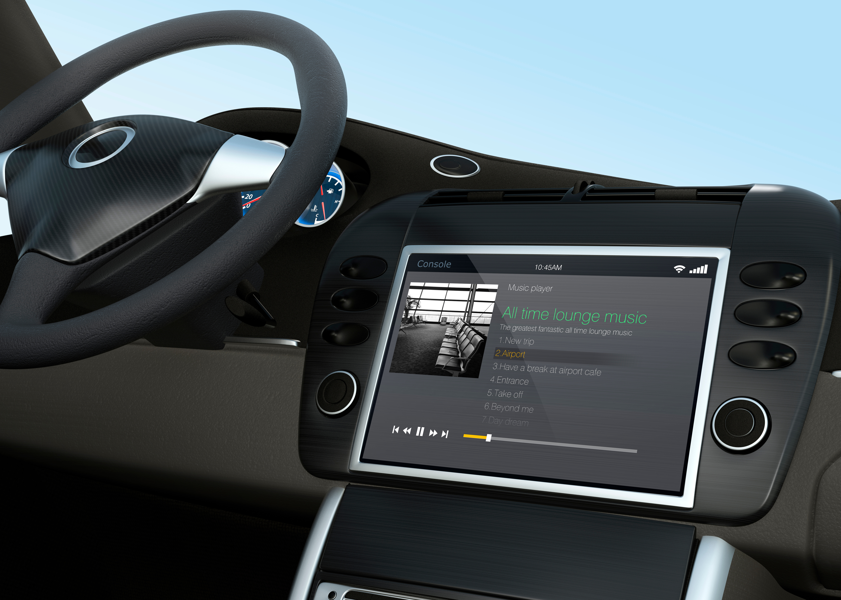
Smart car tech?

Slide 28

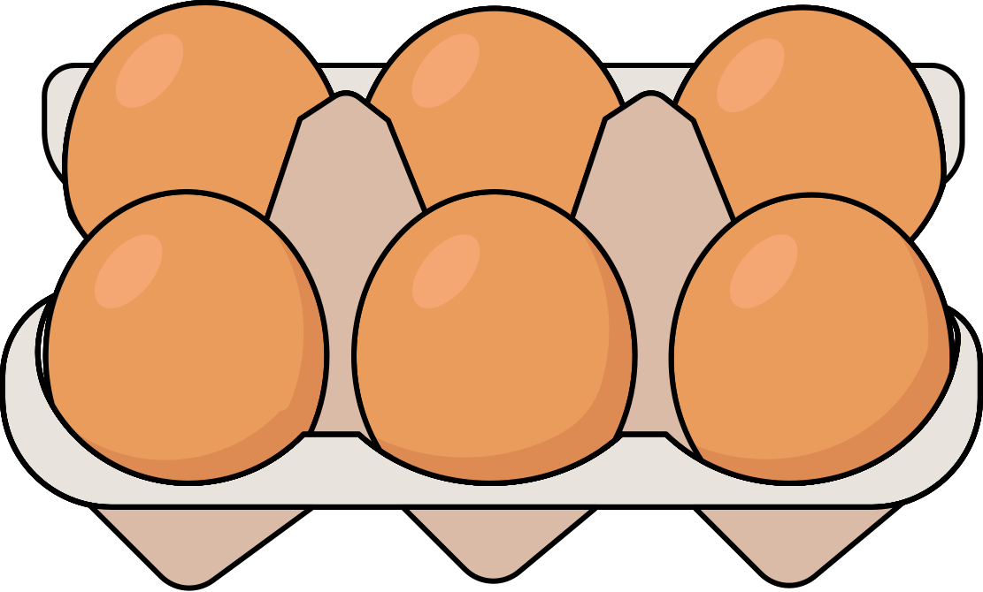
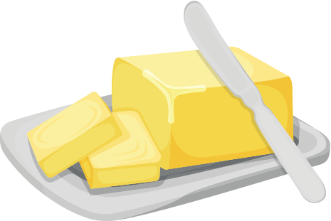
Automatic shopping

Slide 29
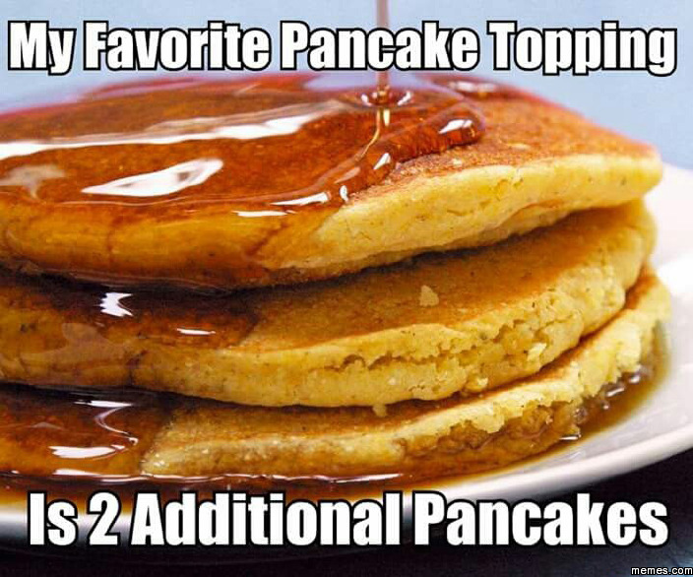

Slide 30
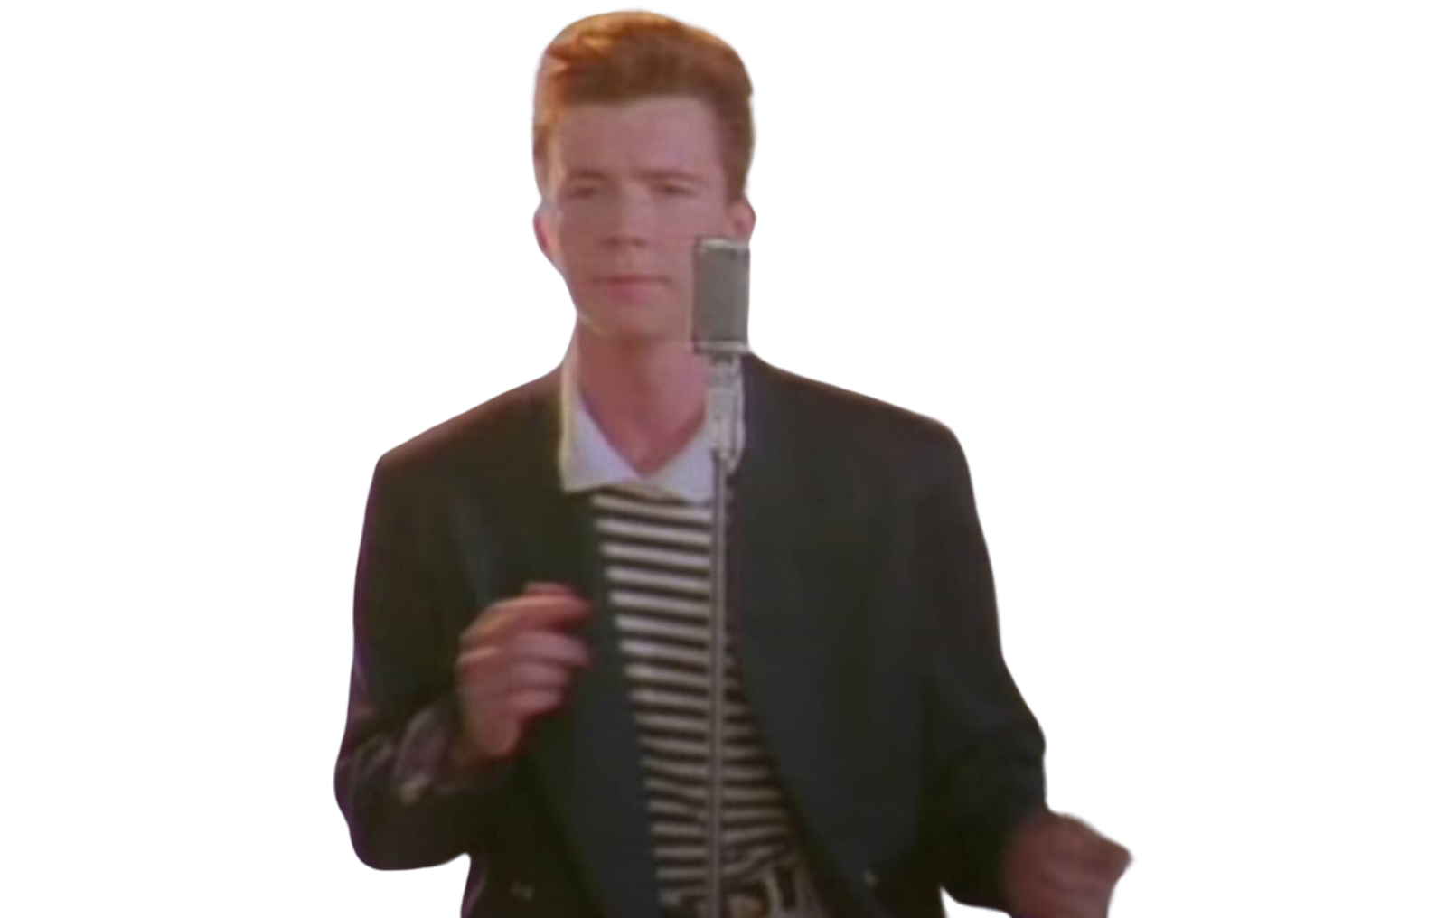

Slide 31
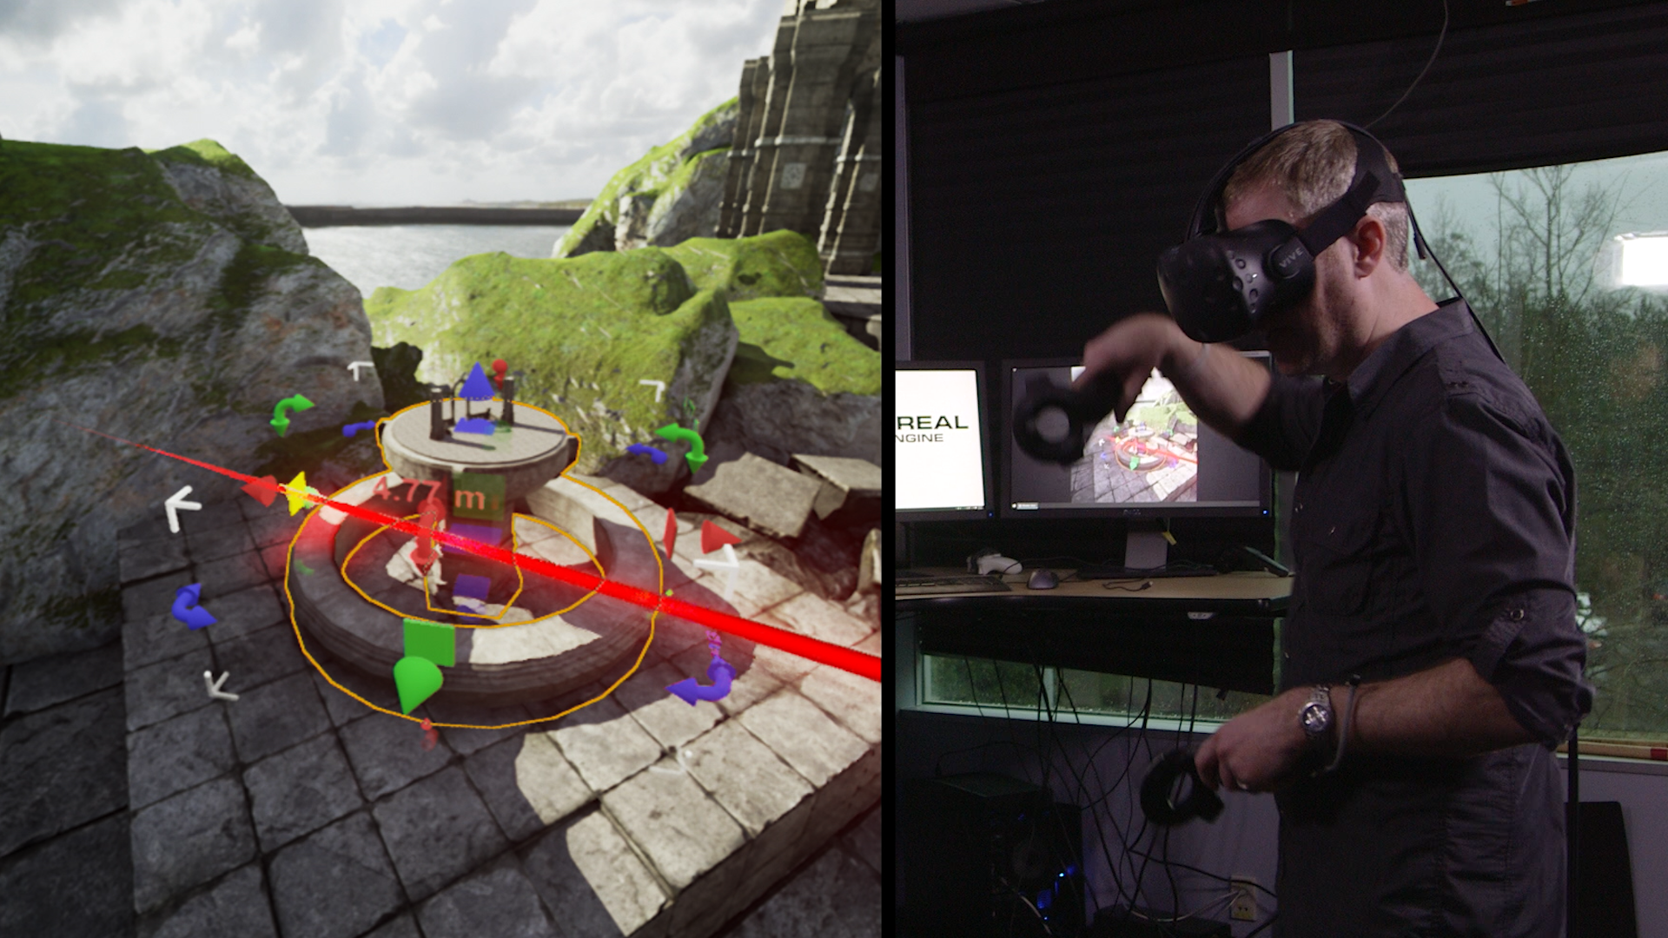
VR game design?

Slide 32
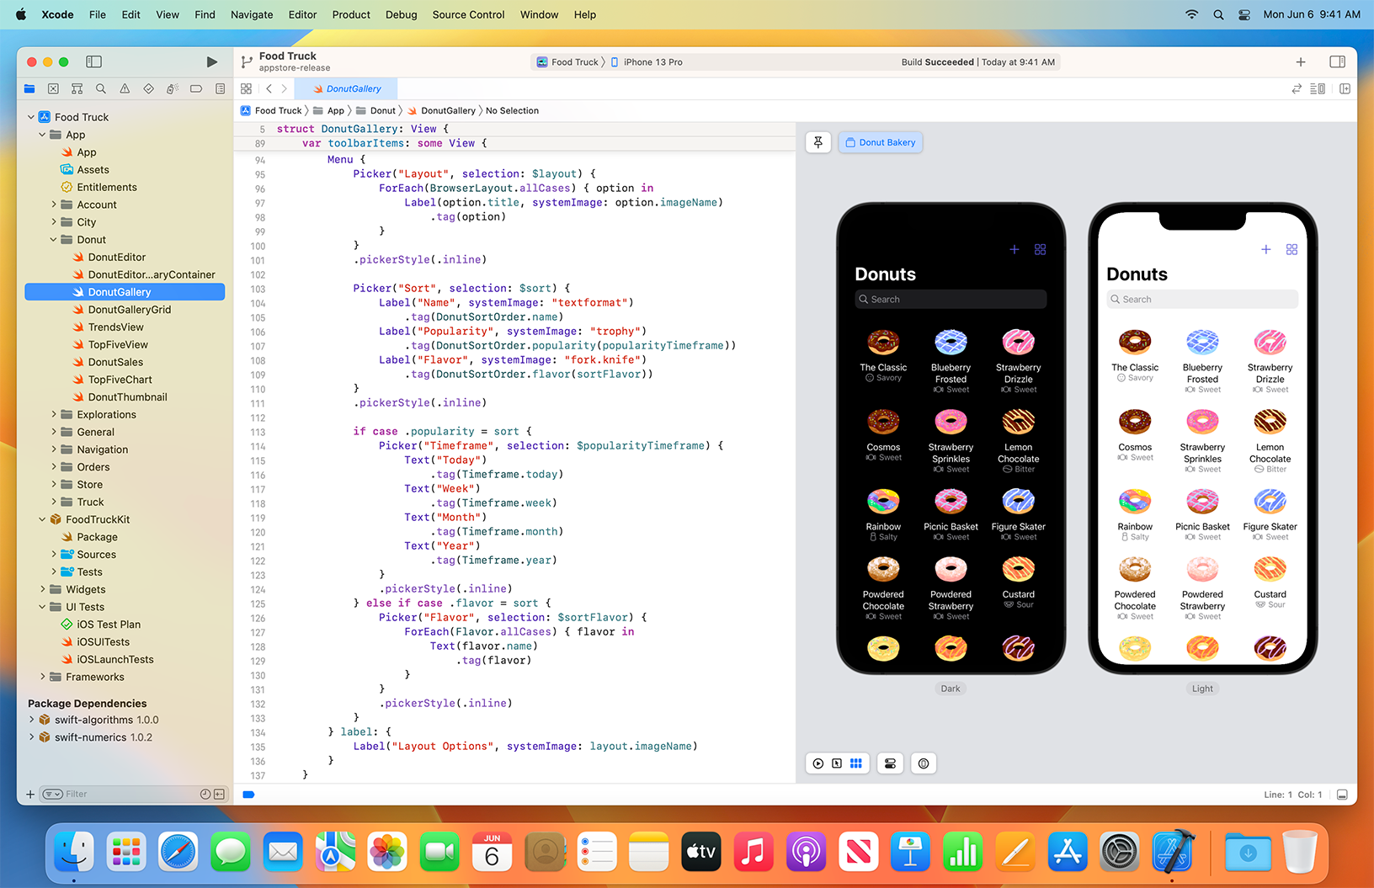
CODING

Slide 33
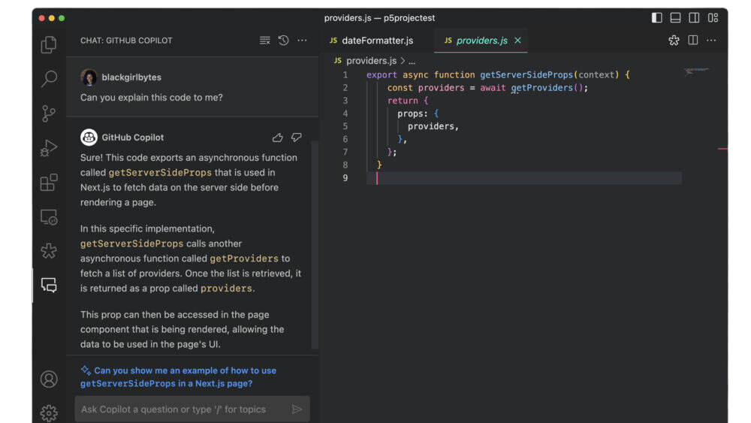

Slide 34
HOW CAN I?

Slide 35
ENGLISH TEST
whats wrong with this sentance

Slide 36
ENGLISH TEST
whats wrong with this sentance
What’s wrong with this sentence?

Slide 37

ENGLISH TEST
Add capitals and punctuation
time flies you cant they fly too fast

Slide 38


ENGLISH TEST
Time flies? You can’t. They fly too fast!

Slide 39
ENGLISH TEST
Time flies? You can’t. They fly too fast!
Think until your brain hurts?

Slide 40
ENGLISH TEST
Time flies? You can’t. They fly too fast!
Think until your brain hurts?
Ask what they mean?

Slide 41
ENGLISH TEST
Time flies? You can’t. They fly too fast!
Think until your brain hurts?
Ask what they mean?
Give up and go for hot chocolate*
* this may actually work
as it may just come to you

Slide 42

DO YOU LIKE RULES?

Slide 43


RULE
If a card has a D on the front then it must have a 3 on the back

Slide 44





CHALLENGE
How many cards must you turn over to be sure that the rule is being followed?
A
D
3
7

Slide 45
CHALLENGE
How many cards must you turn over to be sure that the rule is being followed?
A
D
3
7

Slide 46
CHALLENGE
How many cards must you turn over to be sure that the rule is being followed?
If a card has a D on the front then it must have a 3 on the back
A
D
3
7

Slide 47
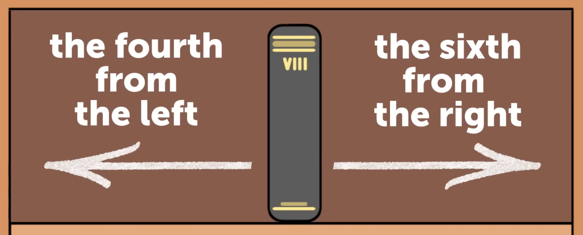
CHALLENGE
How many books are on the shelf?

Slide 48


Slide 49
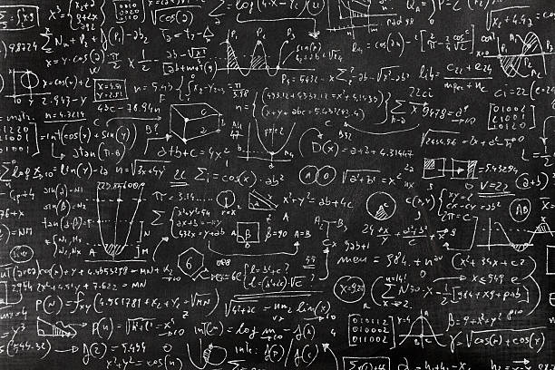

Slide 50
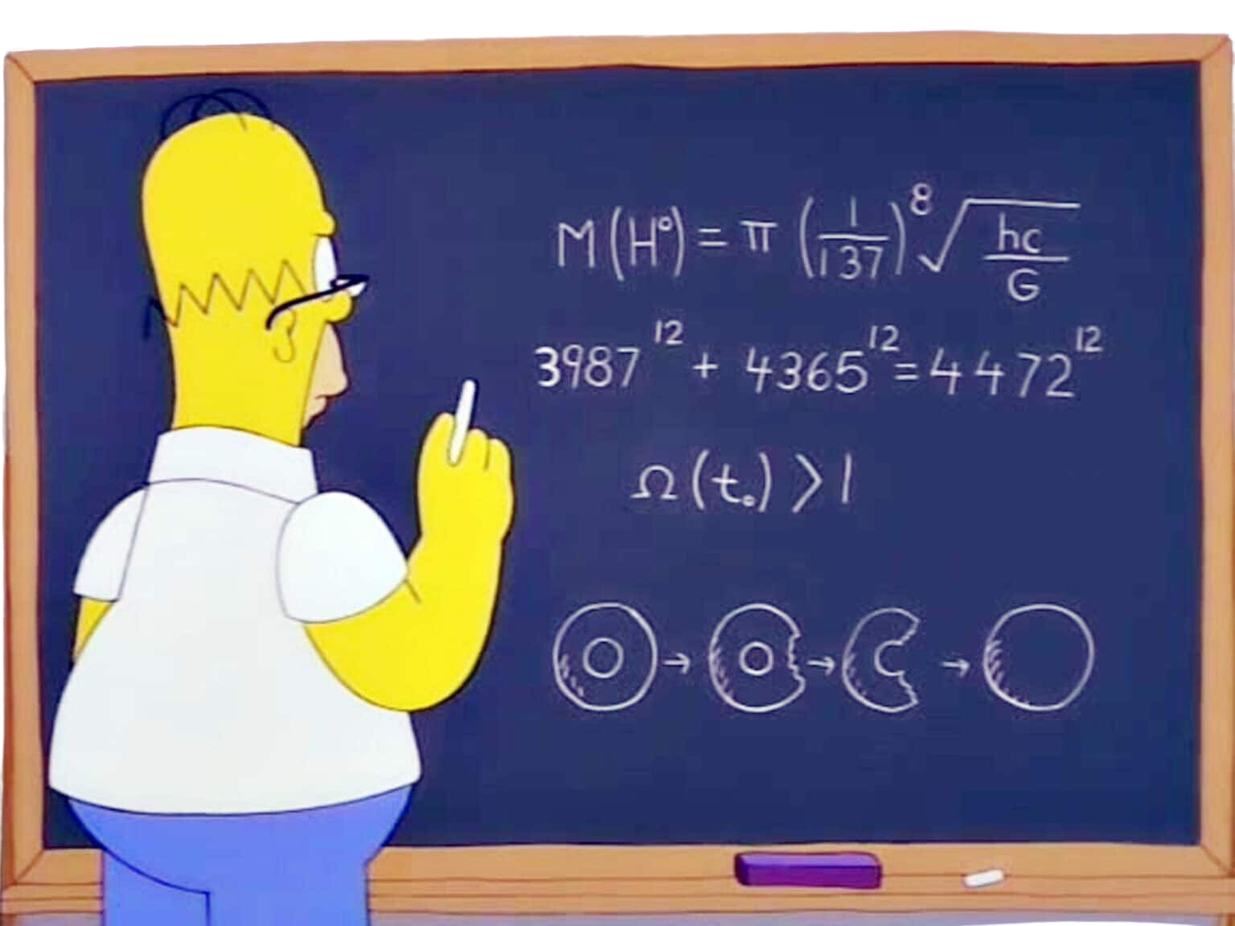

Slide 51
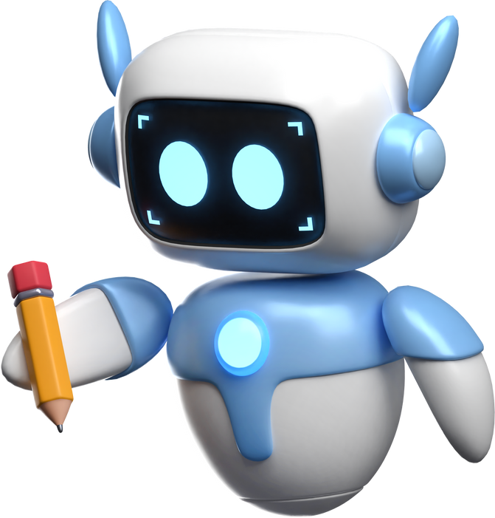
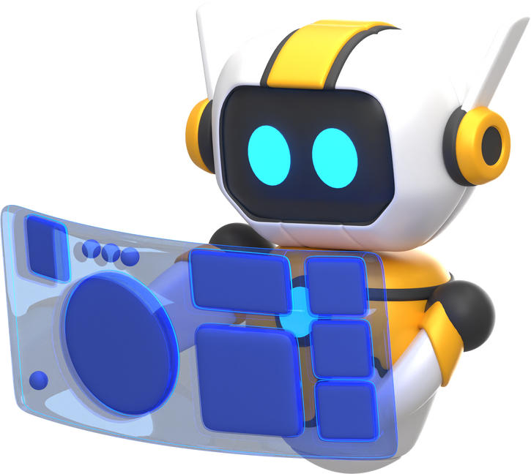
What to learn at school
Important: English
Importanter: Python
Also important: Maths
How to learn at home
DIY
Tutorial websites
Videos
Chatbots
Community

